Slide 1
Enhanced Ultra-High-Vaccum based System for Predicting Field Emission Performance in Metal Matrix Composites
Guide : Sunil Kumar Pradhan
Subhayu Kabiraj (21BEC1757) Shivin Kr. Gupta (21BEC1722) Abhishek Singh (21BEC1758)
January 22, 2025

Slide 2
Overview
We have existing experimental results and data for Al composites with up to 1% weight of graphene addition. Our objective is to predict the current stabilization trend for a case of 1.5% graphene incorporation in Al, utilizing predictive models to extend the analysis beyond the experimental range.
Focus on field emission performance, turn-on field emmission, and other electrical properties.
Integration and verification of theoretically expected trends with the predicted results.

Slide 3
Background
Metal matrix composites have gained significant technological importance due to their excellent thermal and mechanical properties.
AlGr composites are ideal for cathode electron emitters due to their enhanced field emission properties, such as low turn-on field and stable emission current. The incorporation of graphene improves electron mobility and creates efficient emission sites, making AlGr composites suitable for advanced electronic and vacuum device applications.
These composites are widely used in nano/micro-devices and heat collector materials.
Aluminum-based composites are particularly valuable in: Thermo-mechanical/thermo-electrical equipment, Automobile construction, Aerospace industry, Infrastructure materials.

Slide 4
Material Focus
Aluminum powder as the matrix material and Research grade graphene as the reinforcement material.
Enhanced mechanical strength, thermal conductivity, and electrical properties.
Applications in high-performance electronics, aerospace, and nanotechnology.
The metal-graphene interface quality significantly influences both chemical and physical characteristics of the composite. Proper bonding at these interfaces is particularly important for thermal and electrical transport, which directly impacts the material’s performance in device applications.

Slide 5
Existing Research Highlights (1)
The existing research highlighted in the paper focuses on various reinforcement techniques used to enhance aluminum’s properties.
Earlier studies explored the incorporation of materials like aluminum oxide Al₂O₃, boron nitride (BN), and silicon carbide (SiC) into aluminum matrix composites.
More recent research introduced carbon nanotubes (CNTs) and graphene as reinforcement materials due to their exceptional properties including high electron mobility, excellent thermal conductivity, and superior chemical stability.
Previous studies established two main approaches for composite preparation: the dispersion technique and interfacial reaction procedure. High energy ball-milling (HBM) emerged as the preferred method .

Slide 6
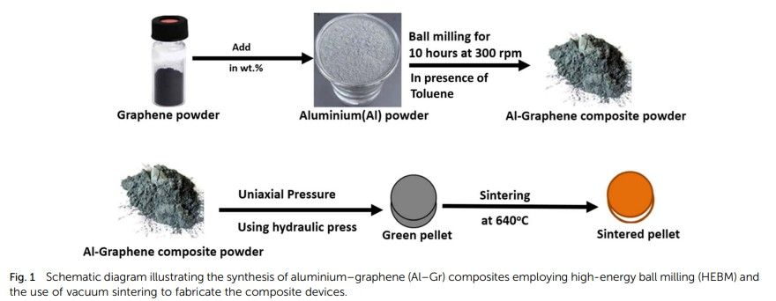
Existing Research Highlights (2)
Advanced material design strategies like powder metallurgy . it is crucial strategy for developing aluminum-graphene composites.
This process involved high-energy ball milling (HBM) where aluminum and graphene powders were mixed in zirconia jars with a specific ball-to-powder ratio of 20:1.
The milling operation was conducted for 10 hours at 300 rpm, enabling uniform distribution of graphene within the aluminum matrix

Slide 7
Problem Statement
Lack of predictive frameworks for AlGr Composites.
Limited understanding of how graphene concentration impacts key properties.
Variability in experimental results due to processing inconsistencies. Insufficient integration of physical theories like Fowler-Nordheim.

Slide 8
Objective
Develop a machine learning pipeline to predict key metrics for AlGr Composites.
Utilize experimental data from Pure-Al, AlGr0.5, and AlGr1.0. Incorporate Fowler-Nordheim theory for field emission phenomena. Employ advanced ML techniques:
Monte-Carlo Technique Random Forests.
Neural Networks for nonlinear relationships. Gaussian Processes for uncertainty quantification.
Multi-task learning across different Gr concentrations in Al lattice.

Slide 9
Methodology
We aim to analyze the current stabilization of AlGr composites and predicting stability using the Monte Carlo method.
This method relies on random sampling and repeated simulations to solve problems that are deterministic in nature but complex to compute analytically.
By simulating a wide range of possible scenarios, the Monte Carlo approach enables us to estimate the behavior of the system under varying conditions. We chose this method because it is highly effective for handling uncertainties and variability in complex systems, making it ideal for modeling the stochastic nature of current stabilization in AlGr composites.
The predicted results are then compared with Fowler-Nordheim (FN) theory and experimental data to observe trends, validate the model, and gain deeper insights into the stabilization behavior.

Slide 10
Model Selection
The Monte Carlo Model is chosen because it is highly effective for solving complex problems involving randomness and uncertainty. It allows for the modeling of systems with multiple variables by generating a large number of random samples and simulating various scenarios. This approach provides statistically robust predictions, even in cases where analytical solutions are challenging or impossible. For AlGr composites, Monte Carlo is particularly useful to estimate current stabilization trends, as it accounts for inherent variability in material properties and external conditions, offering insights that align with experimental observations.

Slide 11
FN - Theory
In Fowler-Nordheim (FN) theory, the relationship between the field emission current density (J) and the applied electric field(E) having a
straight line trend , given in the figure having euation :-
h
i
2 3/2
_{e}2
ϕ
E ϕ
J = A · · exp −B ·
1 −
ln
ϕ
E
16πϵ0ϕ² eE
A =
_{e}3
2
16π hϕ
2mπ
√
B = ⁴
3he
Original FN Theory equation without surface charge correction:
E
2
ϕ
3/2
J = A · · exp −B ·
ϕ
E

Slide 12
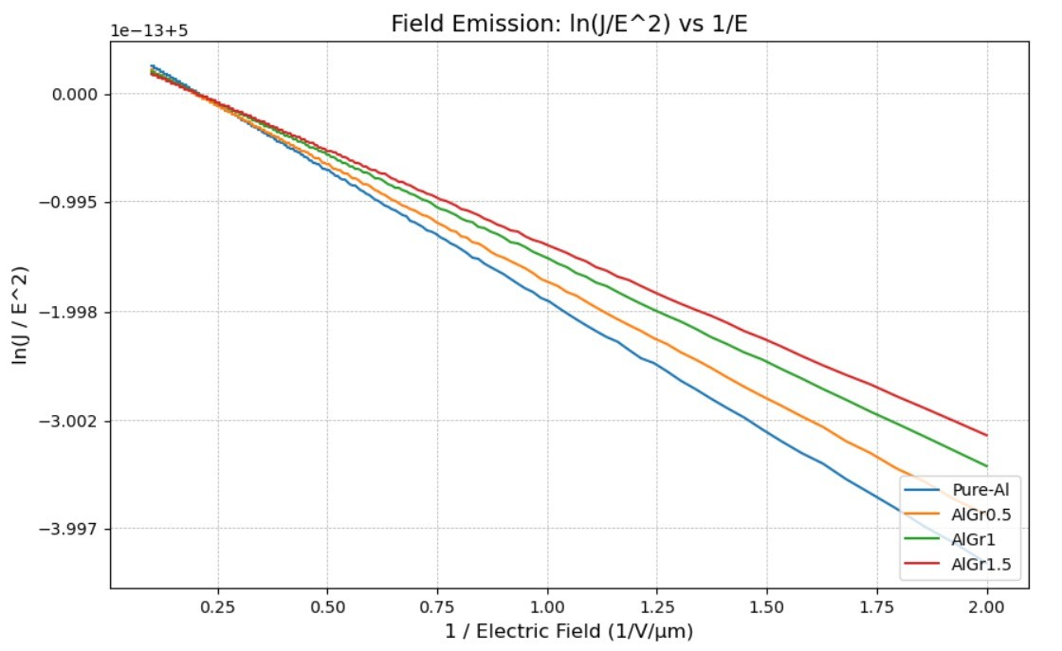
FN- Theory

Slide 13
Expected Results
The FN theory predicts that the turn-on field (minimum electric field required to initiate electron emission) decreases with the presence of effective electron-emitting sites like graphene.
The incorporation of graphene enhances the surface topography and electron mobility, creating additional electron-emitting sites. This aligns with FN predictions that improved material structure leads to better emission efficiency.
The FN theory provides a theoretical framework to validate and interpret the experimental trends observed in the paper, particularly the enhancement in field emission properties with graphene reinforcement.

Slide 14
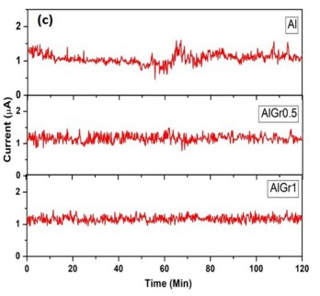
Expected Results
Validate trends with Fowler-Nordheim theory.
Figure: current(uA) vs Time(min)

Slide 15
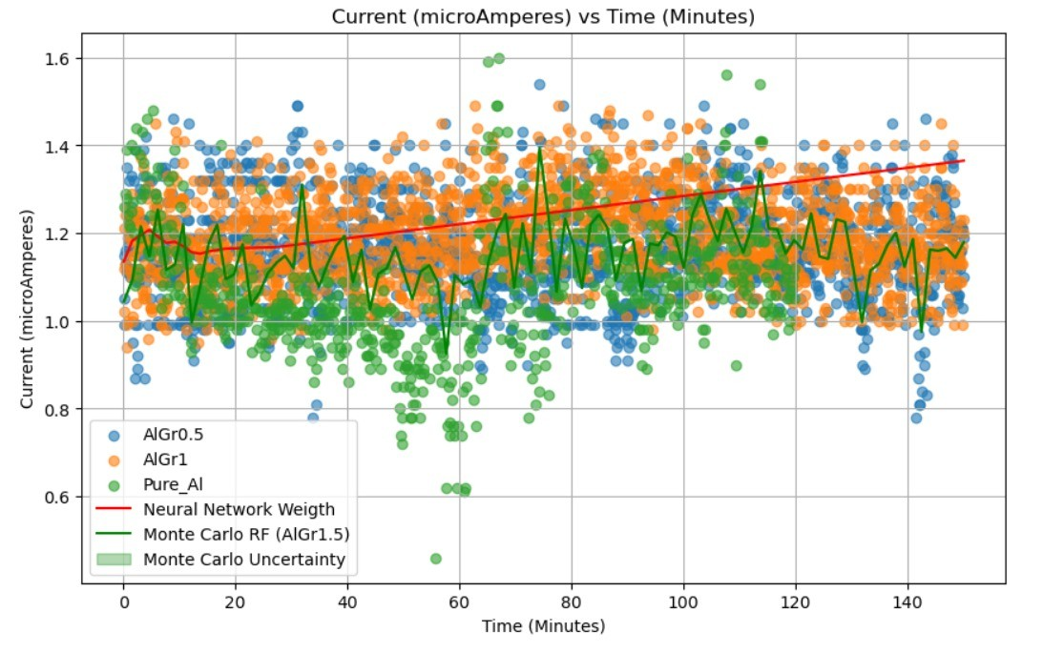
30% implementation
Figure: Current vs Time

Slide 16
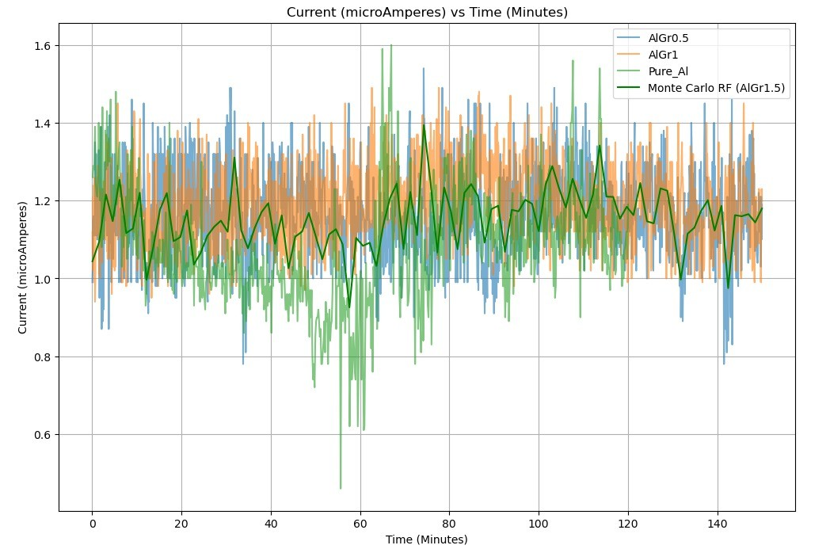
30% implementation
Figure: Current vs Time

Slide 17
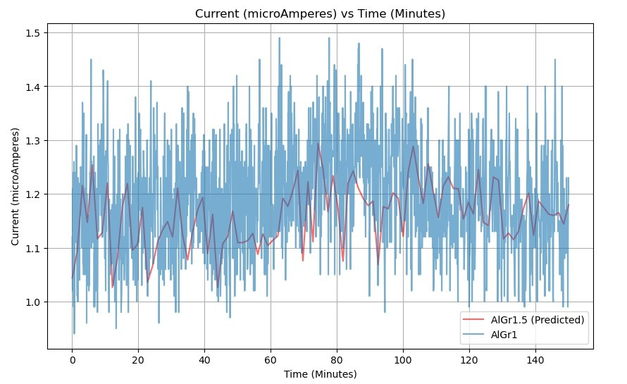
30% implementation
Figure: Current vs Time

Slide 18
Conclusion
Demonstrated ML potential in material property prediction. Application focused on AlGr1.5 and AlGr2.0 alloys.
Encouraged integration of computational and experimental approaches.

Slide 19
Acknowledgments & References (1)
S. C. Tjong, Adv. Eng. Mater., 2007, 9, 639.
L. Lu, M. O. Lai and C. W. Ng, Mater. Sci. Eng. A, 1998, 252, 203.
D. Dafir, G. Guichon, R. Borrelly, S. Cardinal, P. F. Gobin and P. Merle, Mater. Sci. Eng. A, 1991, 144, 311.
H. S. Lee, K. Y. Jeon, H. Y. Kim and S. H. Hong, J. Mater. Sci., 2000, 35, 6231.
C. L. He, J. M. Wang and Q. K. Cai, Adv. Mater. Res., 2011, 194–196, 1437.
Y. M. Youssef and M. El-Sayed, Int. Rev. Mech. Eng., 2016, 10, 261.
J. W. Kaczmar, K. Pietrzak and W. Wl osin´ski, J. Mater. Process. Technol., 2000, 106, 58.
N. Chawla and K. K. Chawla, J. Mater. Sci., 2006, 41, 913–925.
D. B. Miracle, Compos. Sci. Technol., 2005, 65, 2526–2540.

Slide 20
Acknowledgments & References (2)
S. P. Rawal, JOM, 2001, 53, 14–17.
S. T. Mavhungu, E. T. Akinlabi, M. A. Onitiri and F. M. Varachia, Procedia Manuf., 2017, 7, 178.
J. E. Allison and G. S. Cole, JOM, 1993, 45, 19.
S. V. Prasad and P. K. Rohatgi, JOM, 1987, 39, 22.
J. M. G. de Salazar, A. Soria and M. I. Barrena, Sci. Technol. Weld. Join., 2005, 10, 339.
N. Faisal and K. Kumar, J. Exp. Nanosci., 2018, 13, S1.
J. P. Hong, S. W. Yoon, T. Hwang, J.-S. Oh, S.-C. Hong, Y. Lee and J.-D. Nam, Thermochim. Acta, 2012, 537, 70.
P. Yih and D. D. L. Chung, J. Mater. Sci., 1997, 32, 1703–1709.

Slide 21
Acknowledgments & References (3)
K. N. Chethan, A. Pai, N. H. Padmaraj, A. Singhal and S. Sinha, IOP Conf. Ser.: Mater. Sci. Eng., 2018, 377, 12038.
A. Fadavi Boostani, S. Tahamtan, Z. Y. Jiang, D. Wei, S. Yazdani, R. Azari Khosroshahi, R. Taherzadeh Mousavian, J. Xu, X. Zhang and D. Gong, Composites, Part A, 2015, 68, 155.
P. Hidalgo-Manrique, S. Yan, F. Lin, Q. Hong, I. A. Kinloch, X. Chen,
R. J. Young, X. Zhang and S. Dai, J. Mater. Sci., 2017, 52, 13466.
21. A. Mitra, M. R. Sahoo, A. Samal, S. K. Pradhan, B. Polai, K. R. Sahoo, S. Kar, B. K. Satpathy, T. N. Narayanan, P. M. Ajayan, P. V. Satyam and S. K. Nayak, Oxford Open Mater. Sci., 2023, 3(1), itac015.

